Slide 1
The Art of
Inference
What’s the difference between making an observation and making an inference?

Slide 2
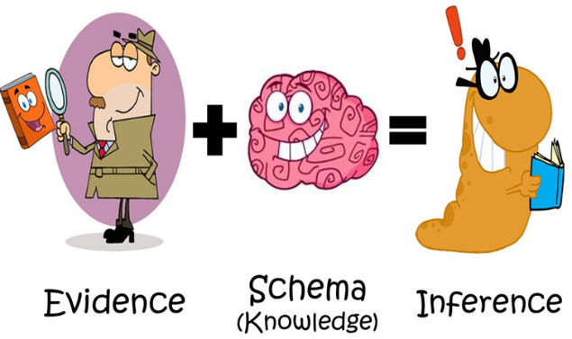
Making observations is a basic skill that simply list facts
"What do you see?“
“What do you know for a fact?”
Making inferences consists of making educated assumptions about a piece of work without having all of the information.

Slide 3
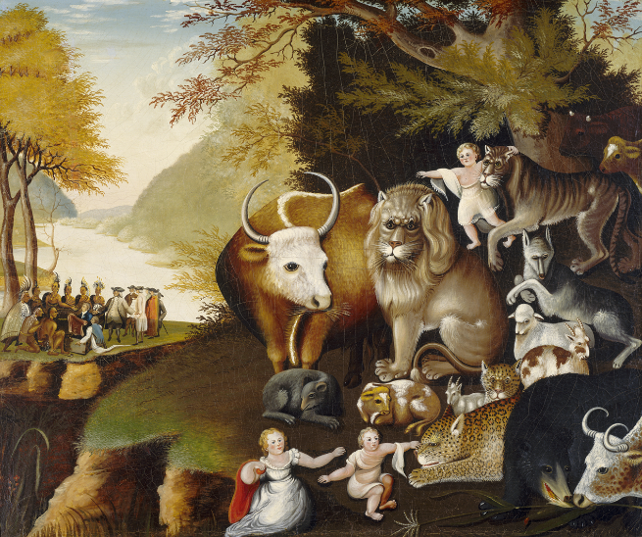
What do you think this painting is about?
What would you call this painting if you were the artist?
What are the similarities and differences between the group of people and the group of animals?
How many main stories are being told in the painting?
What message do you think the artist is trying to portray?
What is the mood of this painting? Angry? Peaceful? Happy? Sad?
Notes:
The Peaceable Kingdom, 1845-46. Edward Hicks painted many versions of The Peaceable Kingdom, taking the theme from a passage from the Book of Isaiah, 11:6-8, which tells of all the animals gathering together in harmony.

Slide 4
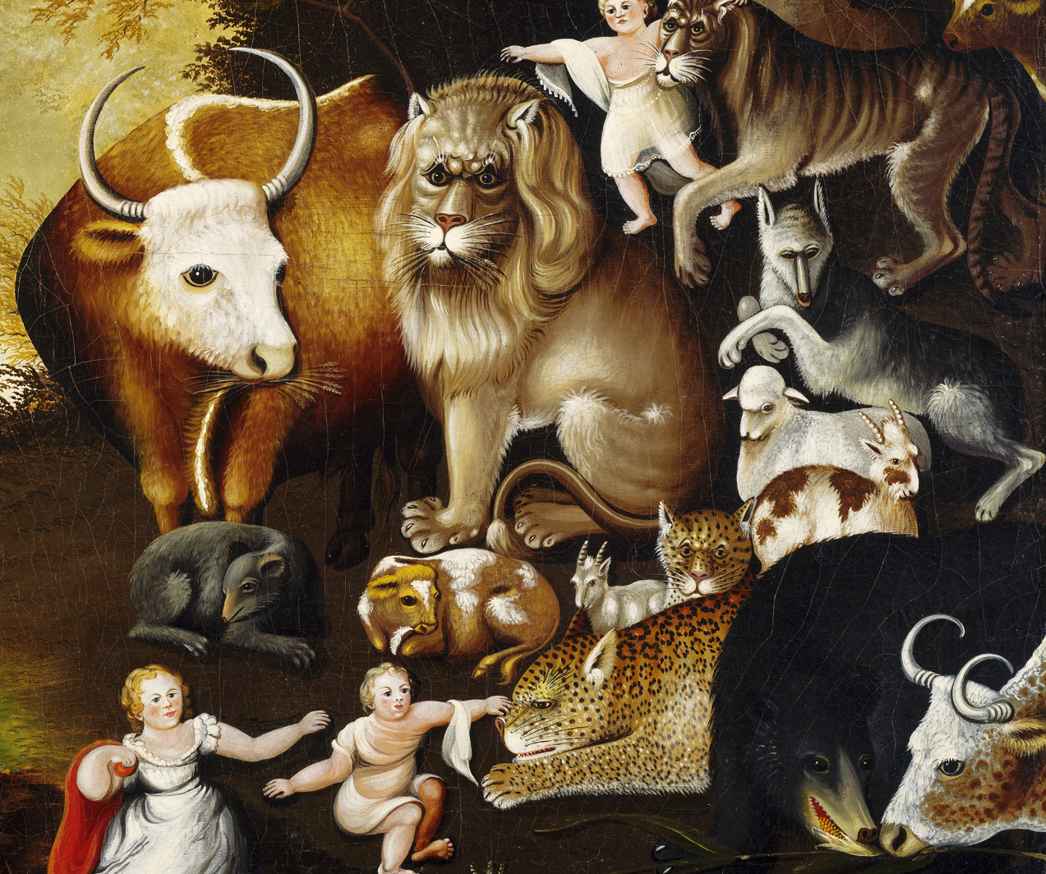
Do these animals look happy, scared, angry, sad, peaceful, tired, joyful?
What is the significance of these groupings of animals?
What do you think the message of this painting is with the depiction of these types of animals together?
Notes:
The Peaceable Kingdom by Edward Hicks painted the animals described in a passage from the Bible. In this story, the prophet Isaiah predicts that one day all of the world’s creatures will live peacefully together.
Both predator and prey exist peacefully together. The gray wolf rests beside a small lamb. A leopard lays his head
between his two muscular front legs, showing no aggression toward
the goat beside him. The lion nuzzles his head against the child.

Slide 5
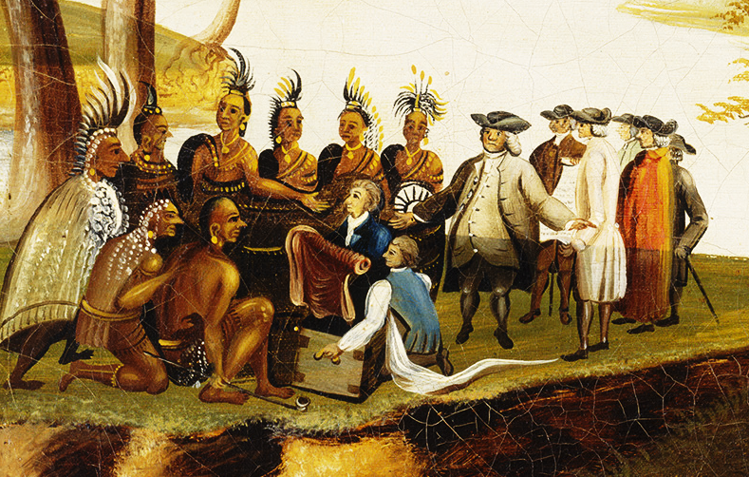
On the grassy riverbank, a group of people meets under a branch of an elm tree. Look closely at their clothing and you’ll notice that the men on the right are British colonists and the men on the left are American Indians.
What could they be discussing?
Notes:
The colonists and American Indians in the background of the painting tell a parallel story of peace from Philadelphia history. Here William Penn (1644–1718), the English Quaker who founded Pennsylvania, meets peacefully with American Indians. A legend tells that Penn signed a treaty of friendship with leaders of the Lenni Lenape tribe (“LEN-nee Luh-NAH-pay,” also known as the Delaware Indians) in 1682, under the shade of an elm tree. The story holds that Penn proclaimed: We meet on the broad pathway of good faith and good-will; no advantage shall be taken on either side, but all shall be openness and love. William Penn and the Lenni Lenape tribe agreed to coexist peacefully. Hicks, a fellow Quaker, painted this picture almost one hundred and fifty years after the event occurred. However, the story of the harmonious relationship between Penn and the tribe continued to inspire him. Hicks linked the stories together with words in the decorative border around the painting. Three of the sides paraphrase the Bible verse and the fourth refers to the treaty. Hicks wanted to show that peace could be achieved, even in a world filled with conflict. By reminding viewers of Isaiah’s vision and the treaty between William Penn and the Lenni Lenape, Hicks implied that all adversaries can find reconciliation.

Slide 6
When do you think this painting was made?
Who do you think made it?
Where do you think it is?

Slide 7
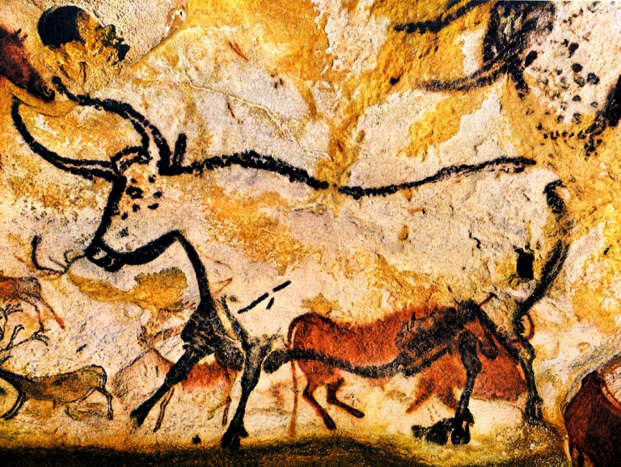
Lascaux cave paintings (Ancient times)
The opening to the Lascaux caves in the south of France was discovered on September 12, 1940 and over 2,000 paintings were found on the walls. The paintings are approximately 17,300 years old and were created using different coloured mineral pigments. Hundreds of these paintings depict animals that roamed the area at the time, including horses, stags, cattle, bison and birds.

Slide 8
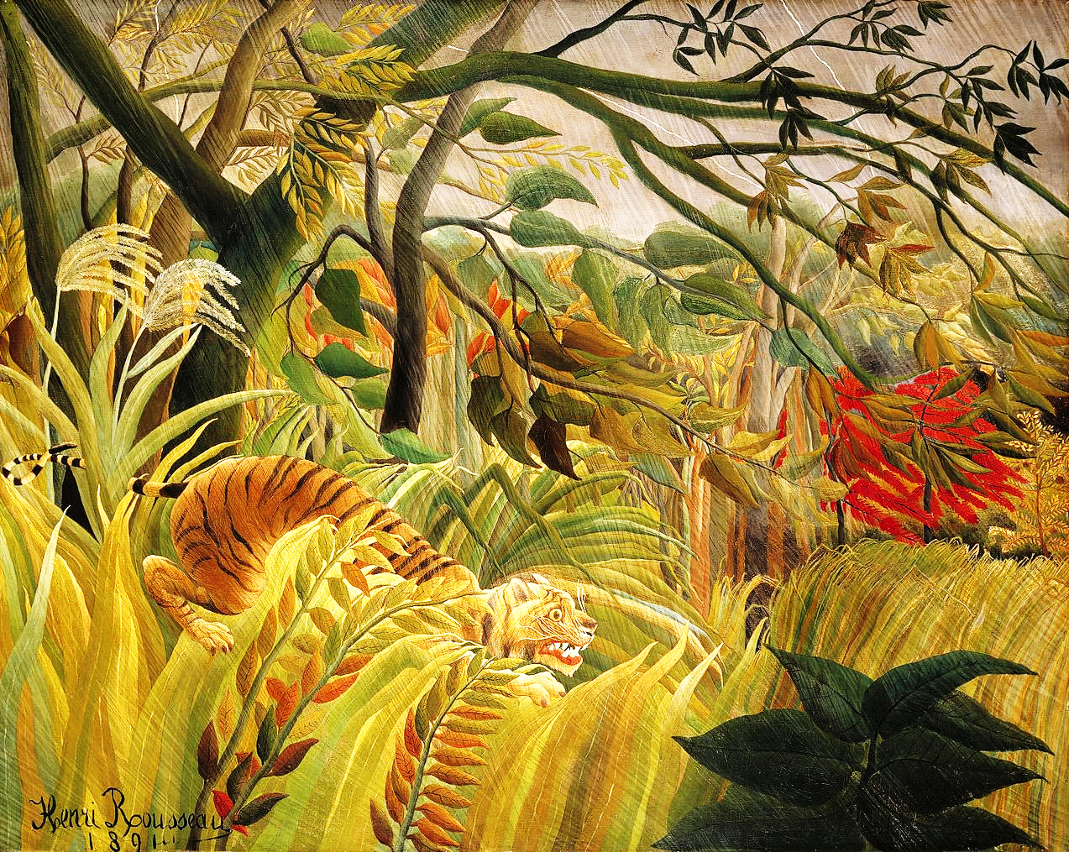
Why do you think the tittle of this painting is called Surprised?
What is the tiger doing?
What do you think will happen?

Slide 9
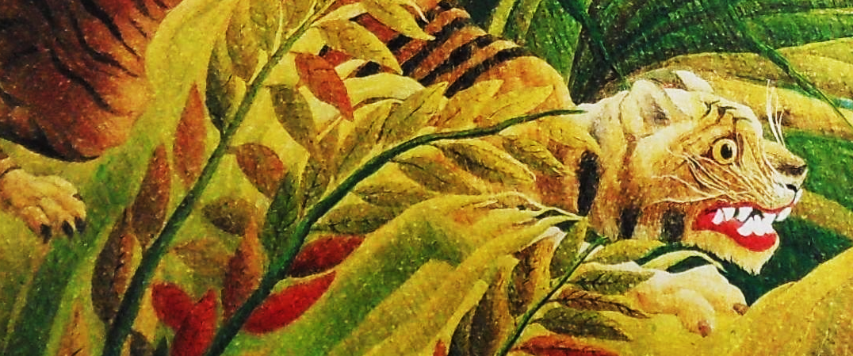
Surprised! by Henri Rousseau (1891)
This is an oil-on-canvas painting showing a tiger preparing to pounce on its prey in during a violent tropical storm. Critics thought his paintings were childish and
The tiger's prey is beyond the edge of the canvas, so it is left to the imagination of the viewer to decide what the outcome will be, although Rousseau's original title Surprised! suggests the tiger has the upper hand. Rousseau later stated that the tiger was about to pounce on a group of explorers.

Slide 10
References
https://www.zippi.co.uk/thestudio/10-famous-animal-paintings/
http://rosecreek.jordandistrict.org/files/2013/10/ArtMasterpiece_KB.pdf
https://www.philamuseum.org/doc_downloads/education/object_resources/56662.pdf
http://rosecreek.jordandistrict.org/files/2013/10/ArtMasterpiece_KB.pdf
https://www.cusd80.com/cms/lib6/AZ01001175/Centricity/Domain/2690/2nd%20Grade-Lesson%204%20February.pdf
https://www.incredibleart.org/lessons/elem/Jeanette-peace.htm
https://www.cusd80.com/cms/lib6/AZ01001175/Centricity/Domain/4107/Lesson%204%20Hicks%20-%20Peaceable%20Kingdom.pdf
https://www.cusd80.com/cms/lib/AZ01001175/Centricity/domain/42/lessons/Hicks.pdf
https://www.teacherspayteachers.com/Product/Making-Inferences-art-activity-3681190
http://speechtimefun.com/using-norman-rockwell-art-to-work-on-inferencing-in-speech-therapy/
https://denverartmuseum.org/edu/lesson/what-s-bear-doing-there-making-inferences
https://www.education.com/lesson-plan/inferring-with-pictures/
http://teachersinstitute.yale.edu/curriculum/units/2012/1/12.01.07.x.html

